Slide 1

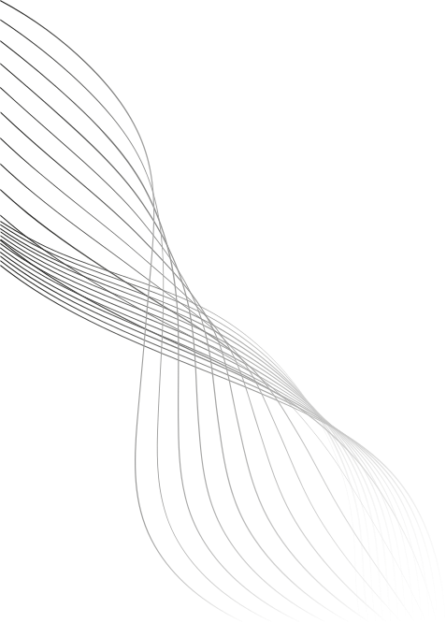
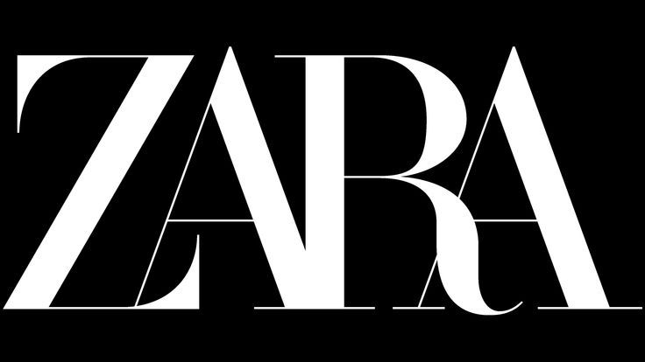
TEAM 13
UNBOXED
IDV PROJECT PRESENTATION

Slide 2

PRESENTING :
A Visual deep dive into the
drivers of Zara’s sales

Slide 3


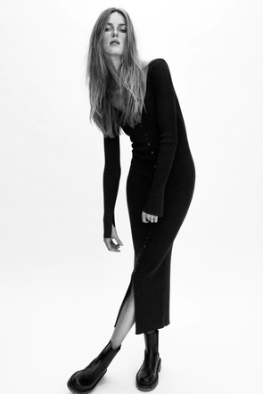
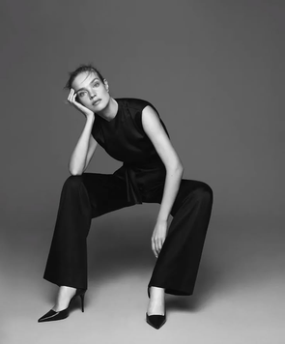
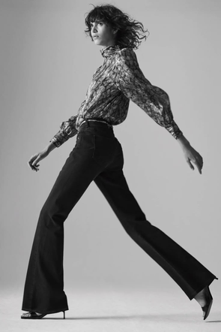
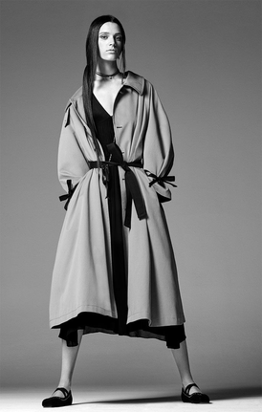
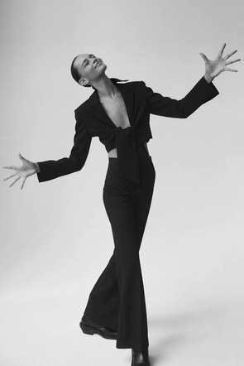
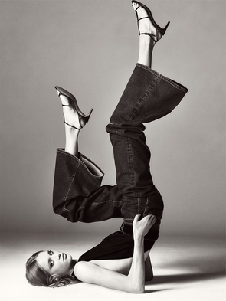
About Zara’s Sales
Growth
In the dynamic landscape of fashion retail, Zara has demonstrated consistent sales growth.
This project aims to uncover the key factors driving this success, exploring how brand perception, pricing strategies, and market positioning contribute to Zara's sustained expansion
FASHION
PRESENTATION

Slide 4
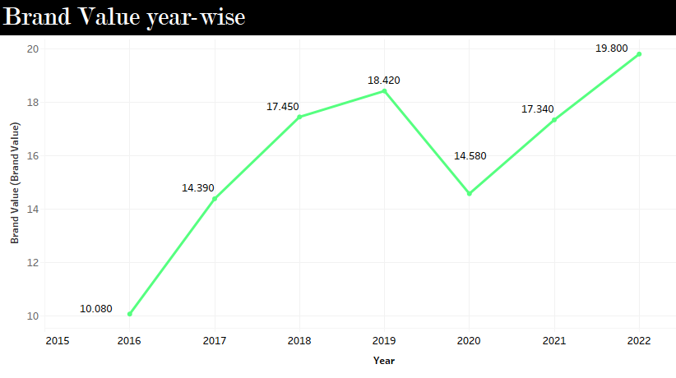
Zara’s Growth
A silent climb—what’s fueling Zara’s unstoppable rise?

Slide 5
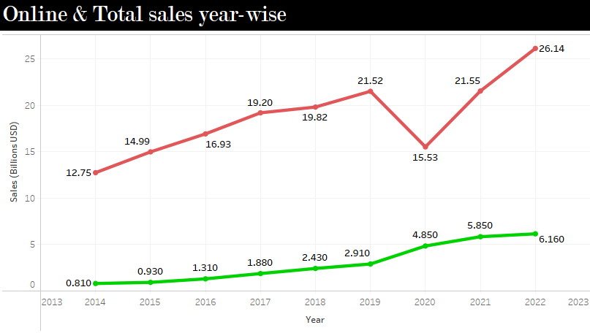
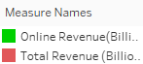
Zara’s Growth
From screen to store, what’s changing the sales game?

Slide 6
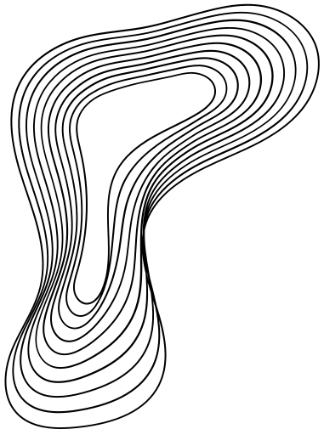
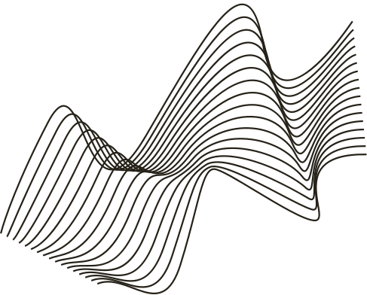
C
ontext : -
Zara has emerged as a global leader in the market, showing steady growth and increasing sales every year, all while spending only 0.3% of its revenue on advertising.
P
roblem : -
Retailers assume traditional retail tactics drive sales. However, these assumptions may not hold true for Zara. This raises a broader question about traditional sales tactics.
Q
uestion :-
We are encountered with specific questions if aggressive promotions, front product placement and seasonal trends drive sales or is it something else?
H
ypothesis :-
H1 :- Zara’s sales growth is influenced by traditional retail levers such as promotions, product positioning, or seasonality.
H2 :- Zara's sales are driven by strategic market postioning.

Slide 7



Hypothesis
Evidence
Claim

Slide 8
Hypothesis
Evidence
Claim

Slide 9
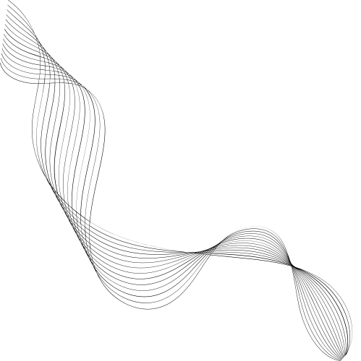
Primary Dataset
Product ID | Product Position | Promotion | Product Category | Seasonal | Sales Volume | name | price | terms | section
185102 | Aisle | No | Clothing | No | 2823 | BASIC PUFFER JACKET | 19.99 | jackets | MAN
188771 | Aisle | No | Clothing | No | 654 | TUXEDO JACKET | 169 | jackets | MAN
180176 | End-cap | Yes | Clothing | Yes | 2220 | SLIM FIT SUIT JACKET | 129 | jackets | MAN
Quantitative
Categorical

Slide 10

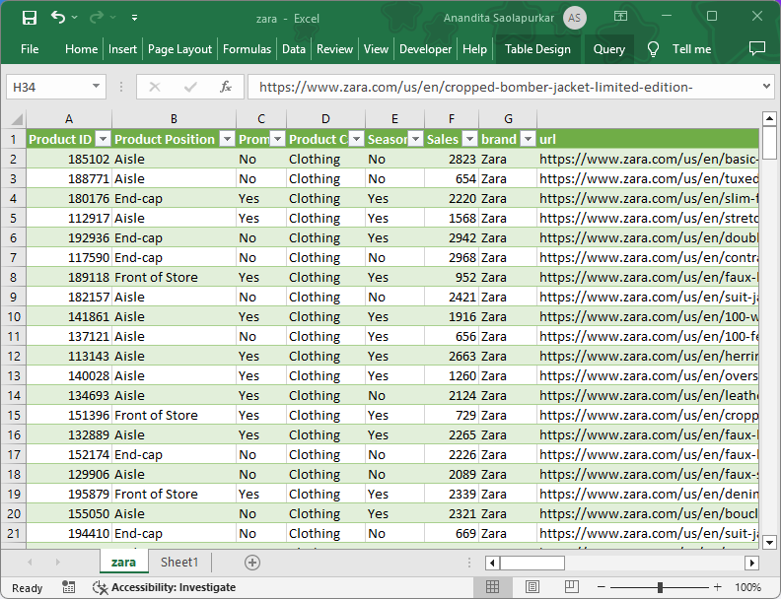


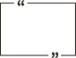
Methodology
The greatest value of a picture is when it forces us to notice what we never expected to see.

Slide 11
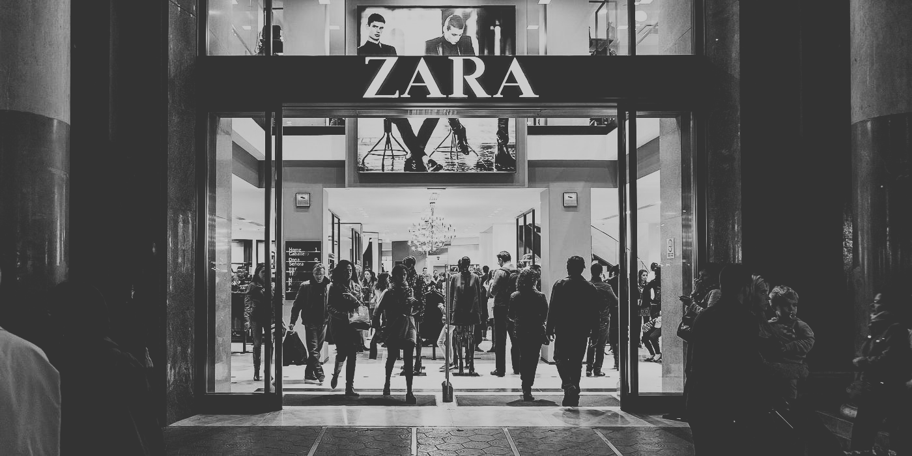
HYPOTHESIS - I
Zara’s sales growth is influenced by traditional retail levers such as promotions, product positioning, seasonality or pricing.

Slide 12
HYPOTHESIS - I
Zara’s sales growth is influenced by traditional retail levers such as promotions, product positioning, seasonality or pricing.

Slide 13
HYPOTHESIS - I
Zara’s sales growth is influenced by traditional retail levers such as promotions, product positioning, seasonality or pricing.

Slide 14
HYPOTHESIS - I
Zara’s sales growth is influenced by traditional retail levers such as promotions, product positioning, seasonality or pricing.

Slide 15
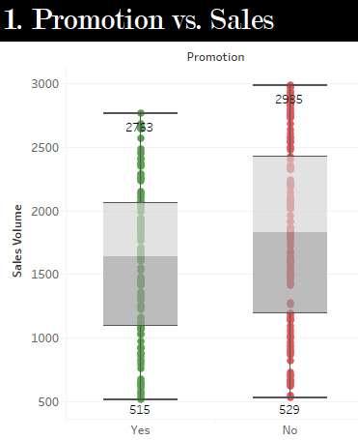
i. Promotions
ii. Product Positioning
iii. Seasonality
HYPOTHESIS - 1

Slide 16
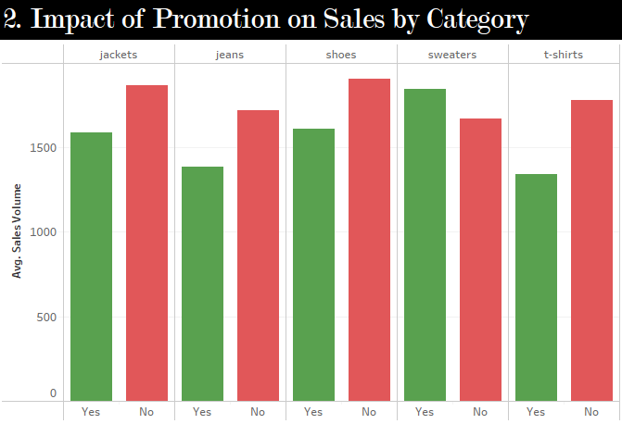
i. Promotions
ii. Product Positioning
iii. Seasonality
HYPOTHESIS - 1

Slide 17

i. Promotions
ii. Product Positioning
iii. Seasonality
HYPOTHESIS - 1

Slide 18
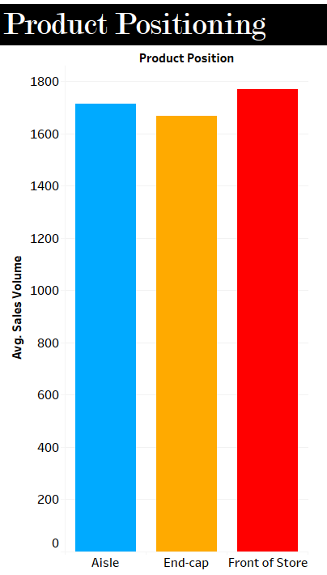
i. Promotions
ii. Product Positioning
iii. Seasonality
HYPOTHESIS - 1

Slide 19
i. Promotions
ii. Product Positioning
iii. Seasonality
HYPOTHESIS - 1

Slide 20
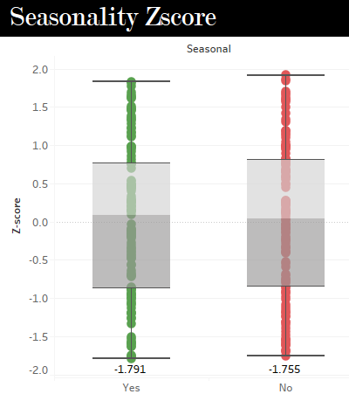
i. Promotions
ii. Product Positioning
iii. Seasonality

Slide 21
i. Promotions
ii. Product Positioning
iii. Seasonality

Slide 22
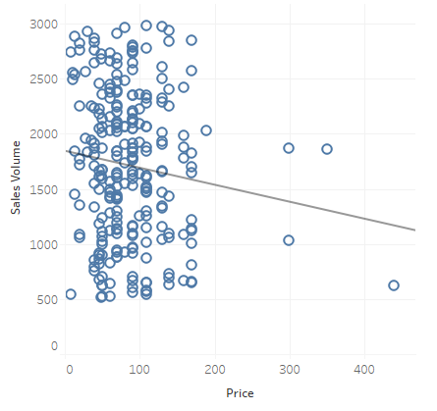
iv. Pricing
R-squared = 0.01
(meaning 0.01% variation of
Sales volume is explained by price)
HYPOTHESIS - 1

Slide 23
iv. Pricing
R-squared = 0.01
(meaning 0.01% variation of
Sales volume is explained by price)
Have we cracked the code?
HYPOTHESIS - 1

Slide 24
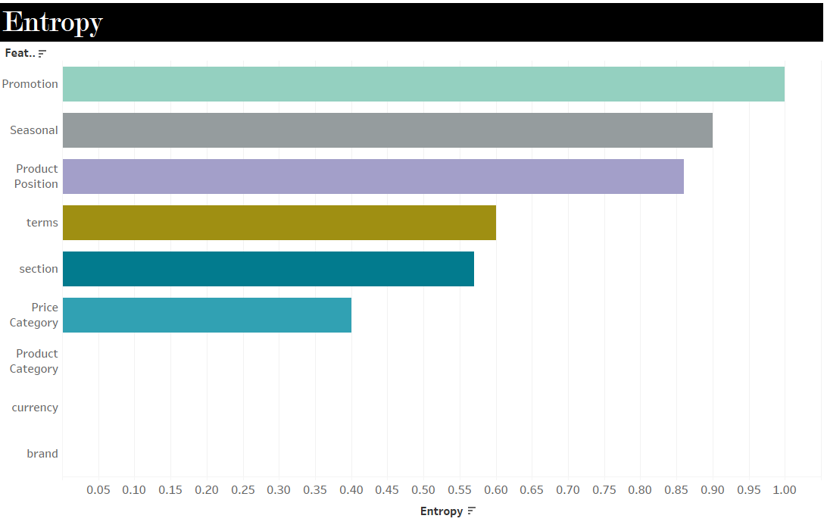
Are you Sure?
Diversity Analysis of Data

Slide 25
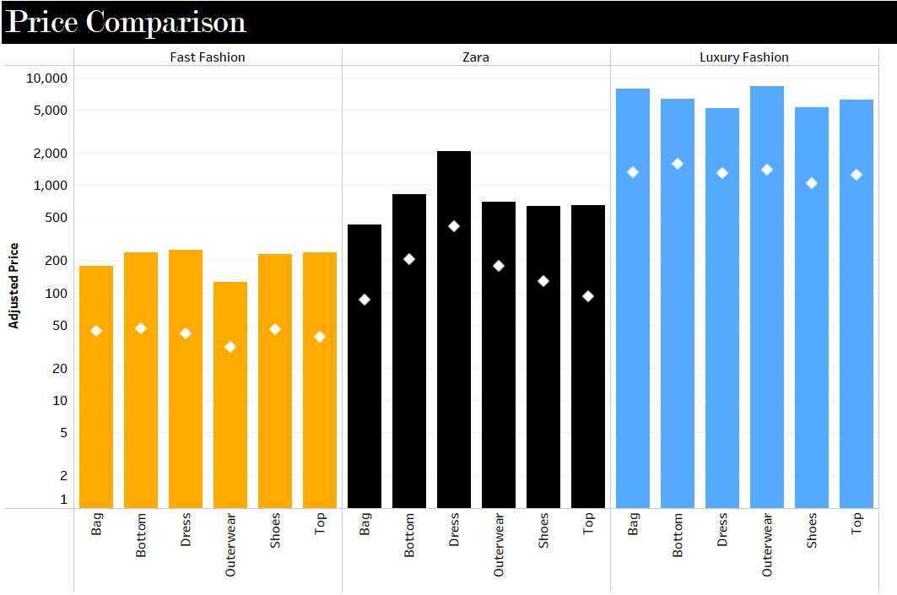
Comparative Analysis
Zara’s price tag fits fast fashion!!

Slide 26
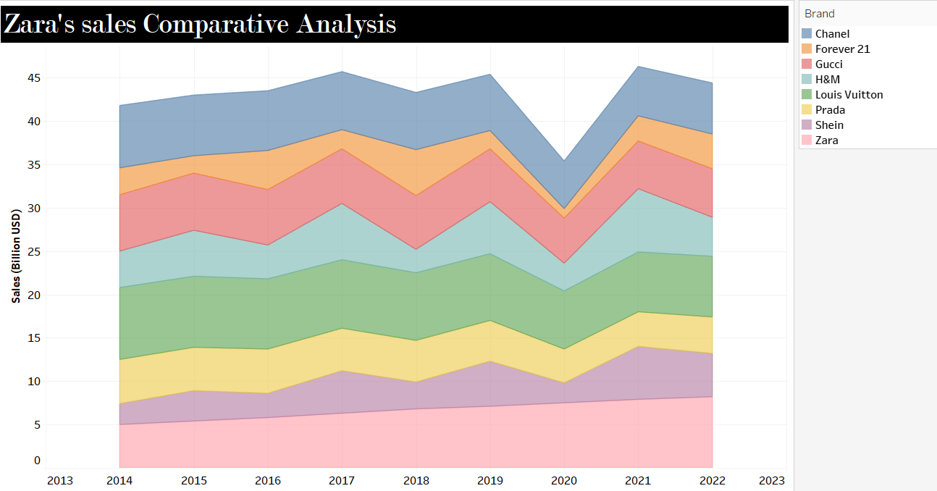
Comparative Analysis
Priced like fast fashion, growing like luxury!!

Slide 27





Zara effortlessly blends two worlds, but how?
fashion
fast
luxury

Slide 28
HYPOTHESIS - II
Zara's sales are driven by strategic market positioning.

Slide 29
Gestalt Principle
Zara’s Gestalt Game: The Psychology of Looking Rich Without Going Broke!!

Slide 30

Gestalt Principle
PROXIMITY
Elements close to each other are perceived as a group

Slide 31
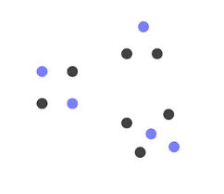
Gestalt Principle
PROXIMITY
SIMILARITY
Elements close to each other are perceived as a group
Items that look alike are seen as part of the same pattern.

Slide 32

Gestalt Principle
PROXIMITY
SIMILARITY
COMMON FATE PRINCIPLE
Elements close to each other are perceived as a group
Items that look alike are seen as part of the same pattern.
Objects moving together are perceived as belonging together.

Slide 33
Gestalt Principle
PROXIMITY
SIMILARITY
COMMON FATE PRINCIPLE
Elements close to each other are perceived as a group
Items that look alike are seen as part of the same pattern.
Objects moving together are perceived as belonging together.
H2-: Zara use them to mimic Luxury!!

Slide 34
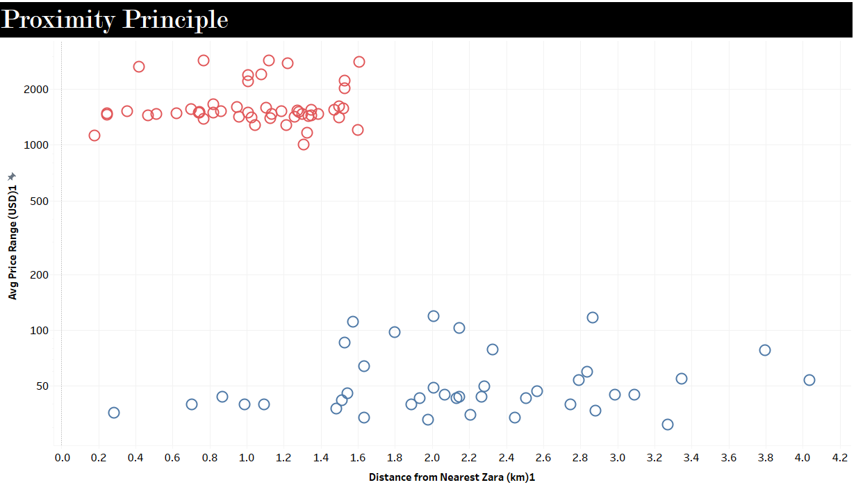
i. Proximity
ii. Similarity
iii. Common Fate Principle
Is Zara choosing its neighbors… strategically?
HYPOTHESIS - 2

Slide 35

i. Proximity
ii. Similarity
iii. Common Fate Principle
Is Zara choosing its neighbors… strategically?
HYPOTHESIS - 2

Slide 36

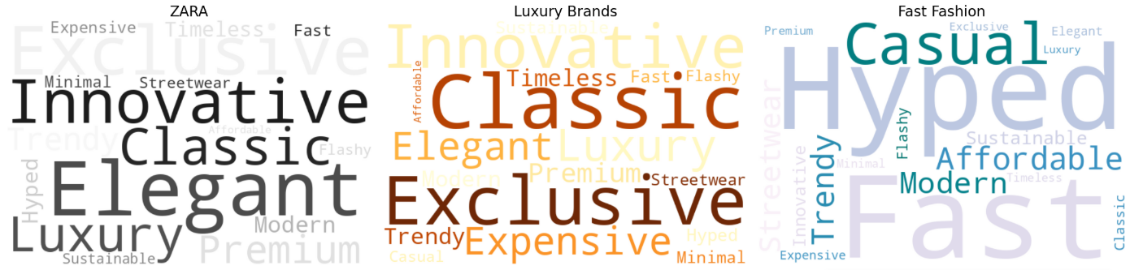
i. Proximity
ii. Similarity
iii. Common Fate Principle
Zara’s Language
HYPOTHESIS - 2

Slide 37
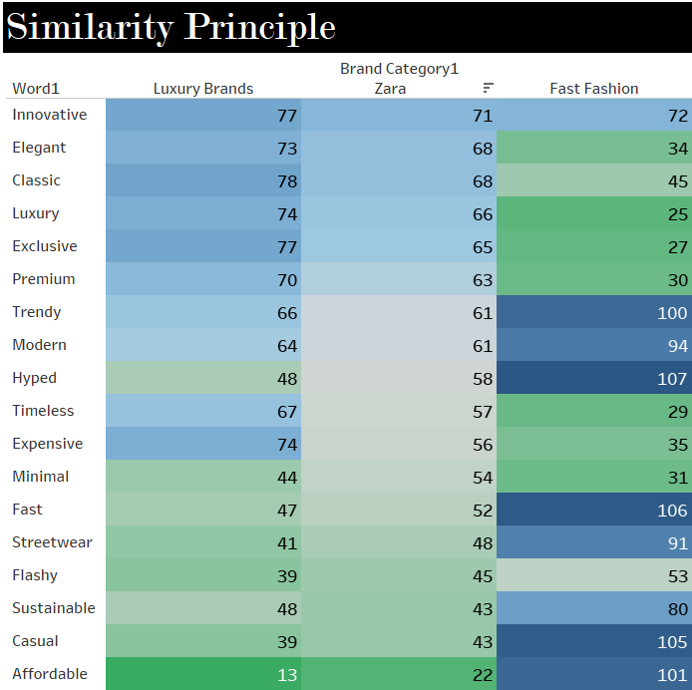
i. Proximity
ii. Similarity
iii. Common Fate Principle
Not Just the Look: Zara Speaks Luxury Too (Here’s How)!!
HYPOTHESIS - 2

Slide 38
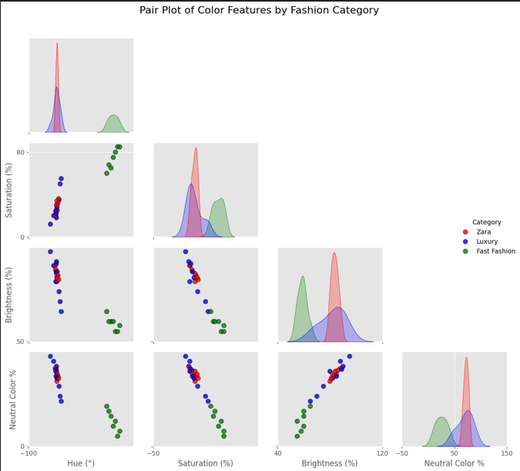
i. Proximity
ii. Similarity
iii. Common Fate Principle
Look Carefully Next time!!
HYPOTHESIS - 2

Slide 39
i. Proximity
ii. Similarity
iii. Common Fate Principle
Zara’s Website Looks Like Dior — And That’s No Accident
HYPOTHESIS - 2

Slide 40
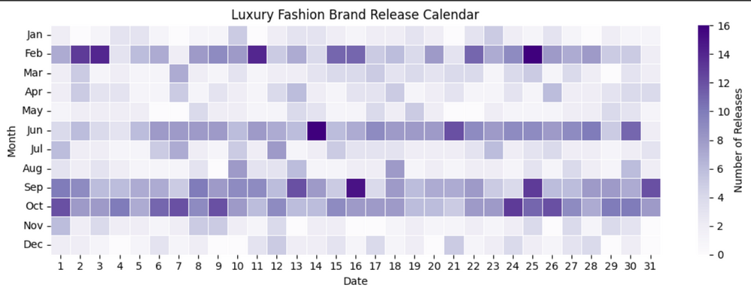
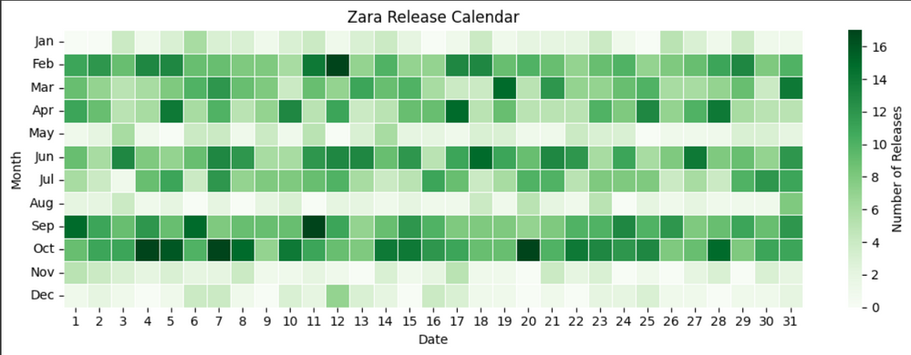
i. Proximity
ii. Similarity
iii. Common Fate Principle
Zara and luxury collections align mere coincidence or calculated fate?
HYPOTHESIS - 2

Slide 41
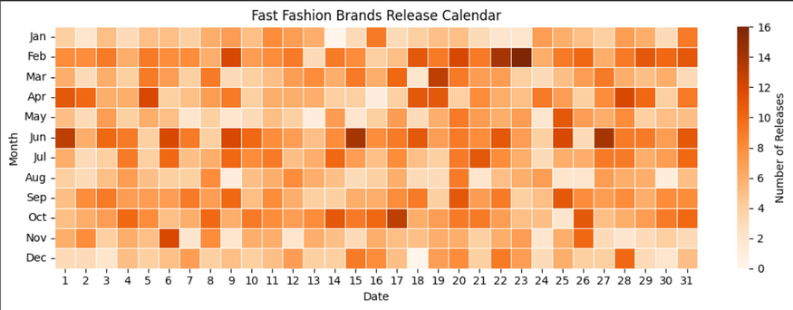
i. Proximity
ii. Similarity
iii. Common Fate Principle
The speed is real. The strategy? That’s the game.
HYPOTHESIS - 2

Slide 42
i. Proximity
ii. Similarity
iii. Common Fate Principle
HYPOTHESIS - 2

Slide 43


But does this help? For this we had to find a way to...
...QUANTIFY Brand Perception

Slide 44
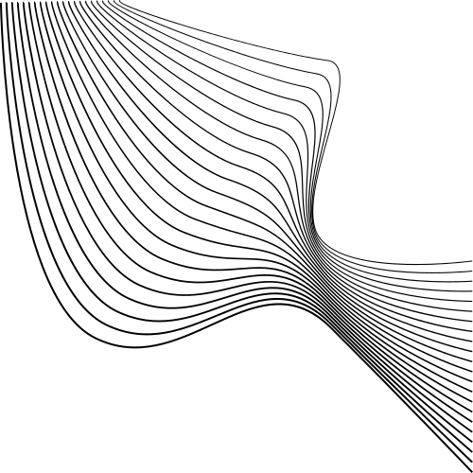
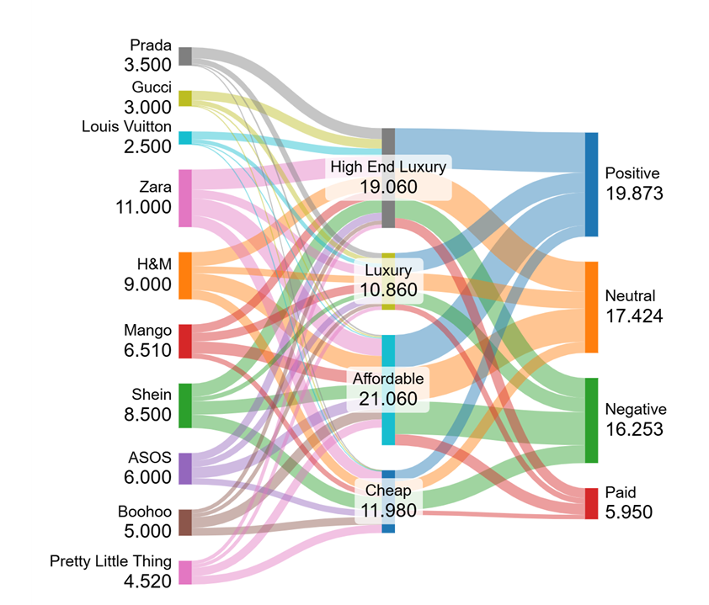

Numeric Perception
Umm.
.. Zara’s Not a Luxury Brand… But Twitter Thinks It Is?
The Chart Explains

Slide 45
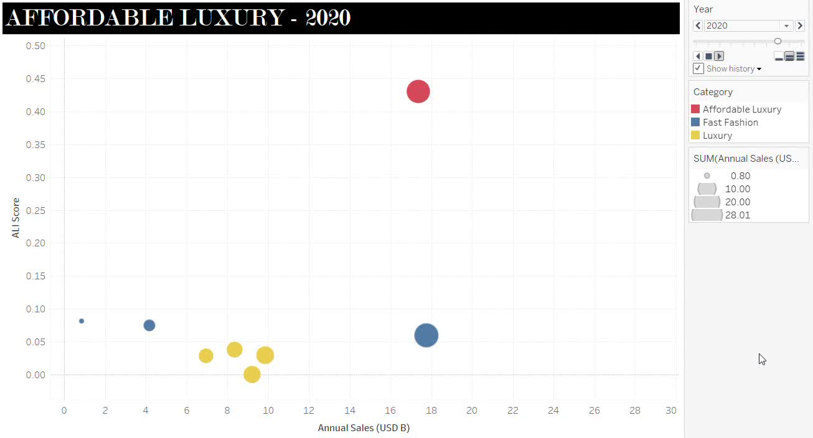
Can prestige at a price fuel unstoppable growth?

Slide 46
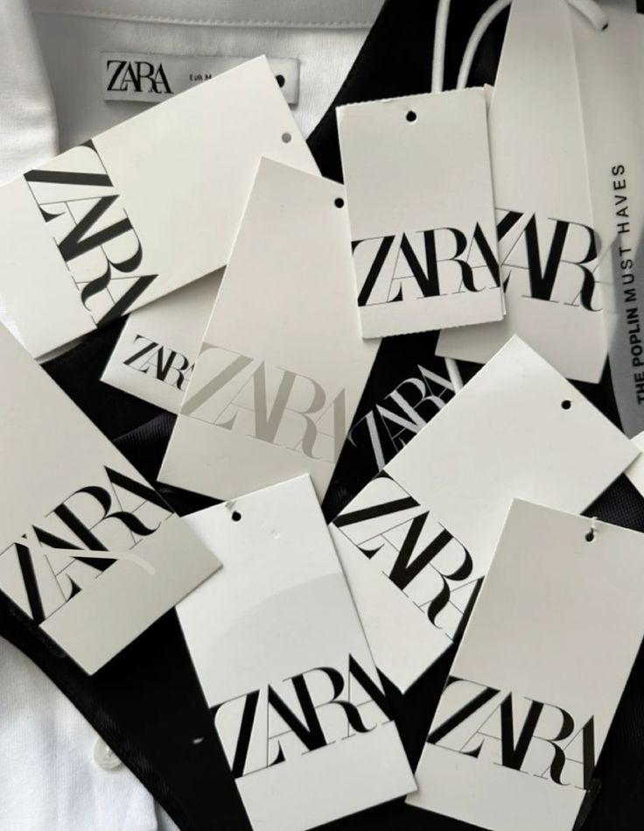
Conclusion
Zara breaks from traditional retail logic—our analysis shows that promotions and seasonality don’t drive its sales. Instead, it wins by combining luxury-like brand perception with fast fashion affordability, carving a unique and dominant position in the market.

